Slide 1



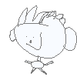
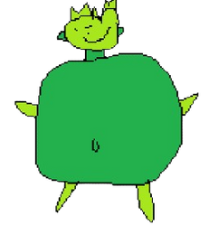

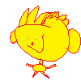
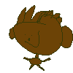
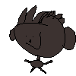
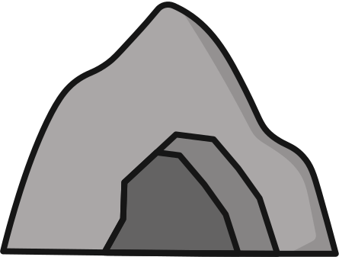


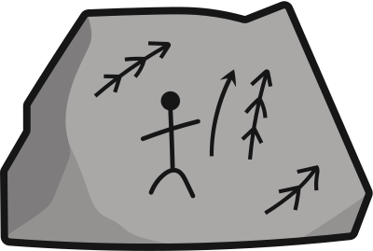


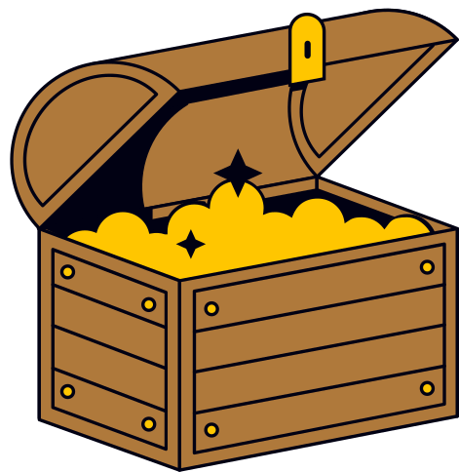
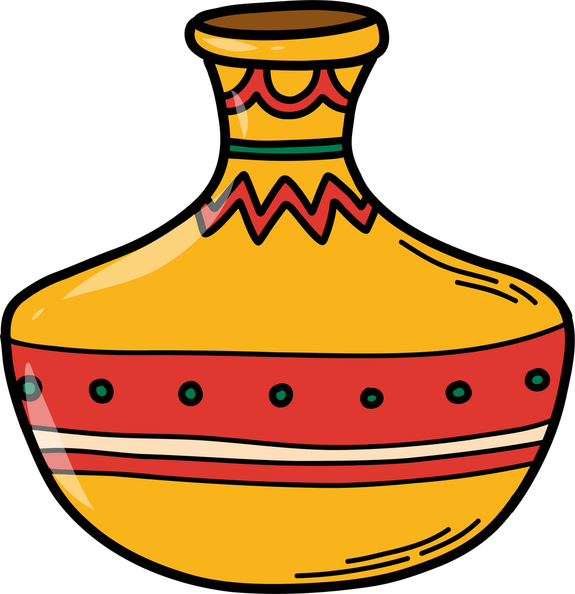
Innovations
Lebob 2025

Slide 2
PLAY

Slide 3

T&Cs apply
Claw
Testing
Design
BUY NOW
4000

Slide 4
Part 1
Planning

Slide 5
research
Different materials
Types of manipulator arms
Stats of common commercial manipulator arms
Primary functions of manipulator arms
Hydraulic and electric manipulator arms
Disadvantages and advantages of each
Control schemes
Common causes of damage
Typical mounting on ROVs
Key parts
See page 3 - 13 of the Innovation Design file

Slide 6
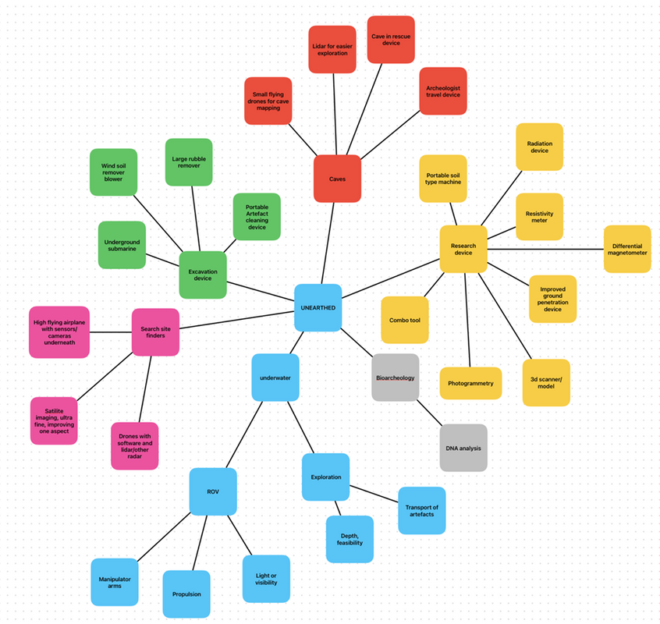
Brainstorm
At the beginning of the season, our team met up to brainstorm issues and possible solutions.
Main goal: Create a physical, working prototype.
How: Coding, CAD software, 3D printing
See page 2 of the Innovation Design file
Notes:
At the beginning of the season, we brainstormed issues and possible solutions. This is our mid map.
We wanted to make a working protoype using coding, CAD and 3D printing.
Here's the problem that we found.

Slide 7
Problem
Current industry grippers used in archaeology are:
Expensive
Specialised gear
Transport of this gear
Slow
Transport time between places
Long delays due to incorrect parts
Inefficient gripping slows recovery, less time efficient
Risky
Heightens the chance of damaging artefacts
Summary: Archaeologists need manipulators purpose-built for fragile artefact recovery, not repurposed industrial grippers.
See page 3 of the Innovation Design file

Slide 8
Possible Solutions
1. Pressure sensors on claw that stop the claw when exerting too much pressure
2. Using a vacuum to pick up objects
3. Soft flexible pads on tips of claws to more safely handle artifacts
4. kit models that are cheaper to build
See page 14 of the Innovation Design file

Slide 9
Chosen Solution
Archaeologists switch from expensive grippers to a kit for them to use to assemble the grippers.
Low cost: Cheap as there is no need for expensive industrial tools, instead 3D printed parts will suffice
Easy to replace: Simple parts allow for easy replacement
Fewer moving parts: Simple design prevents risk of damage to gripper
Buy in bulk: Teams are able to buy our gripper kit in bulk, allowing for easy replacements.
See page 14 of the Innovation Design file

Slide 10
Solution (CONT..)
Our redesigned archaeological claw fixes the core problems of industrial ROV grippers.
1. Soft adaptive finger pads
2. Pressure-sensing fingertips
3. Modular 3D-printable claw
Result
The kit turns a basic gripper into a safe, adaptable archaeological tool that protects fragile objects and gives operators real control underwater.
See page 14 of the Innovation Design file

Slide 11
Part 2
Real life product

Slide 12
Materials
Originally, during regionals, chose to use titanium or anodised aluminium because they were strong and corrosion resistant but expensive.
After talking with experts, we decided to use plastics, as they are cheaper
Specifically, Nylon 12 Carbon Filled
See page 14 - 15 of the Innovation Design file
Notes:
Originally, we chose Titanium or Aluminium, because they were strong and corrosion resistant but expensive.
Experts said it was better to use plastic.

Slide 13
Cost
Predicted cost of plastic - $15
Predicted cost of electronics - $100
Predicted cost of connector - $300
Predicted total - $415 (AUD)
Nylon 12 CF - $120 per 1 kg (eSun ePA-12 Nylon 3D Print Filament 1kg 1.75mm), total print amount is 125 grams
See page 14 - 15 of the Innovation Design file

Slide 14
What our Project Does
Our project has three main sections:
Body: the rack and pinion and surrounding support, connects to the rest of the manipulator arm
Fingers: long, with minimal flex and curve inwards, allows for a large range of objects to be collected
Fingertips: contains the pressure sensors and pads, gives sensory feedback and allows for better grip
See page 14 of the Innovation Design file

Slide 15
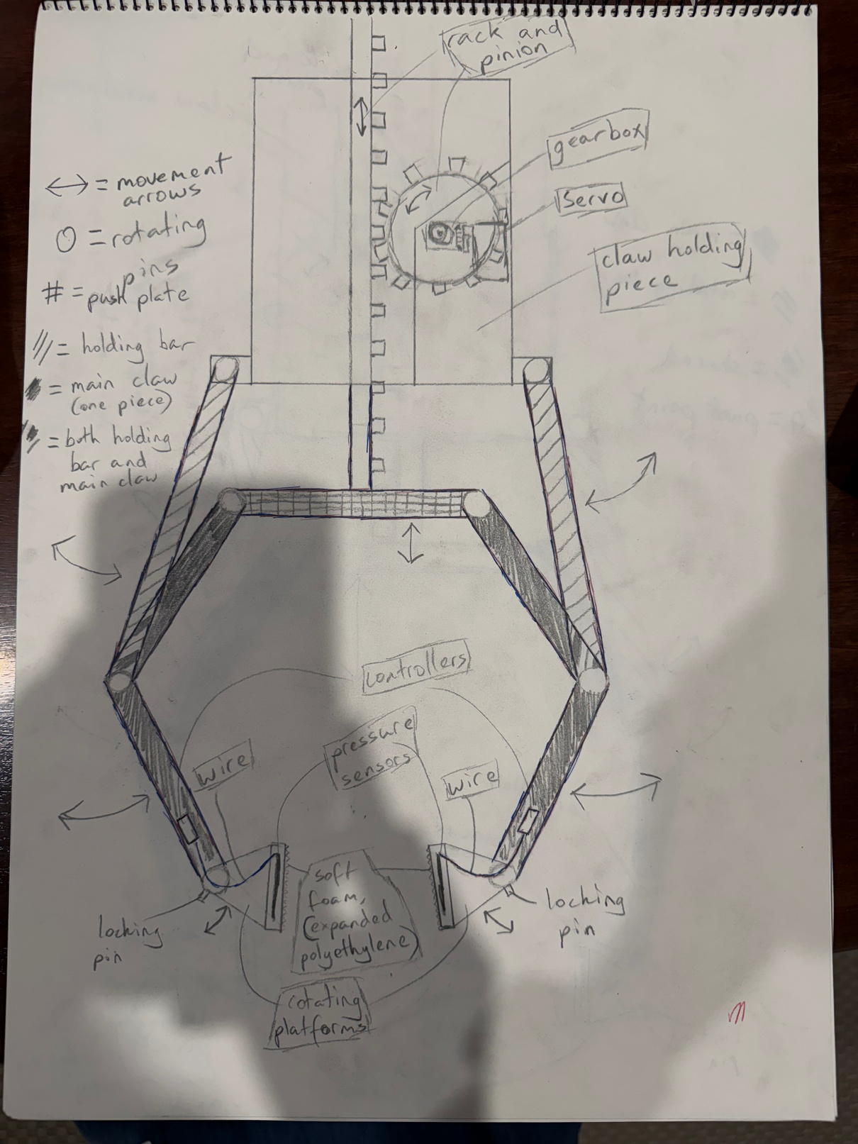
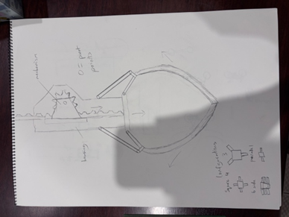
early prototype drawing
Design
This is are sketches of our design of our innovations project.
final concept drawing
Please refer to the sketchpad

Slide 16
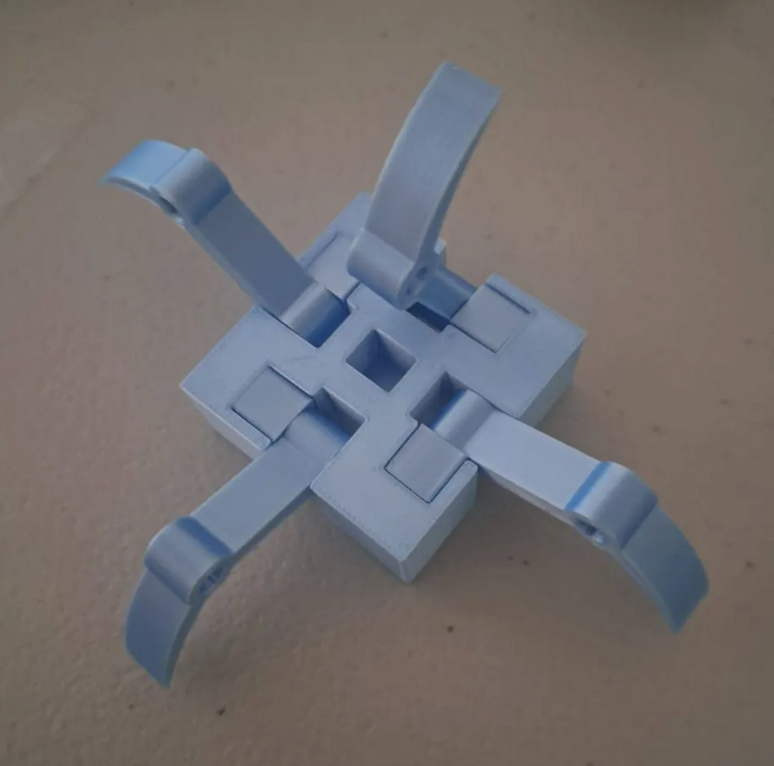
Changes we made
Prototype: We used a quick filament printer to do quick prototyping.
Proof of concept: Simple claw to test the rack and pinion mechanism
Final: CADed and printed in resin
Additions: Pressure sensor and the grippers
See pages 15 and 17 of the Innovation Design file

Slide 17
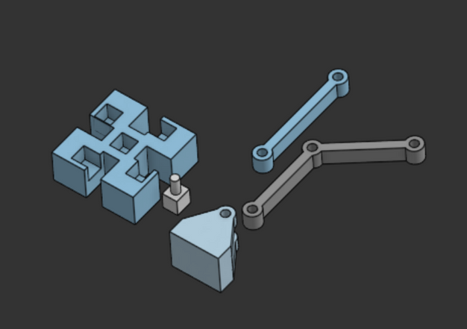

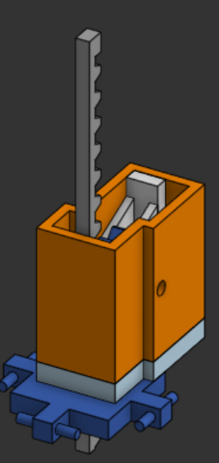
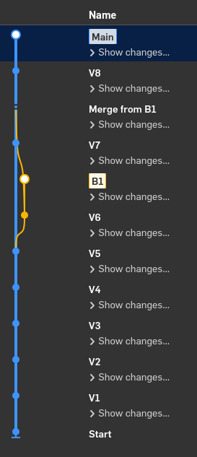
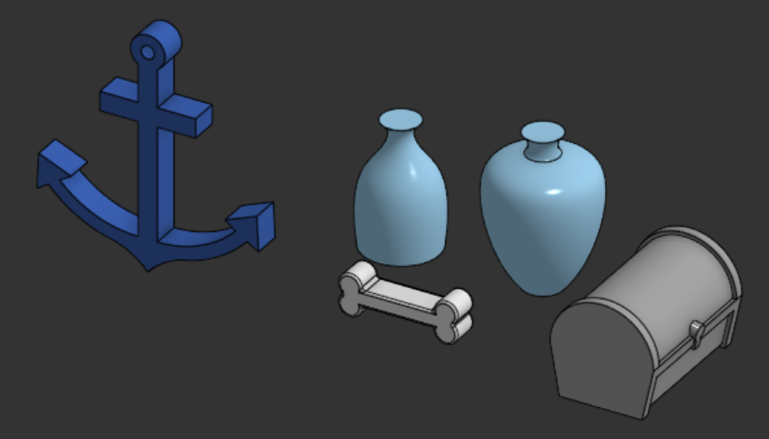
Onshape
We modelled the claw in Onshape because it made collaboration way easier.
Cloud-based workflow: Everyone can edit the same model online
Real-time collaboration
Built-in version control: Onshape tracks every change automatically. We could branch ideas, compare versions and roll back when needed.

Slide 18
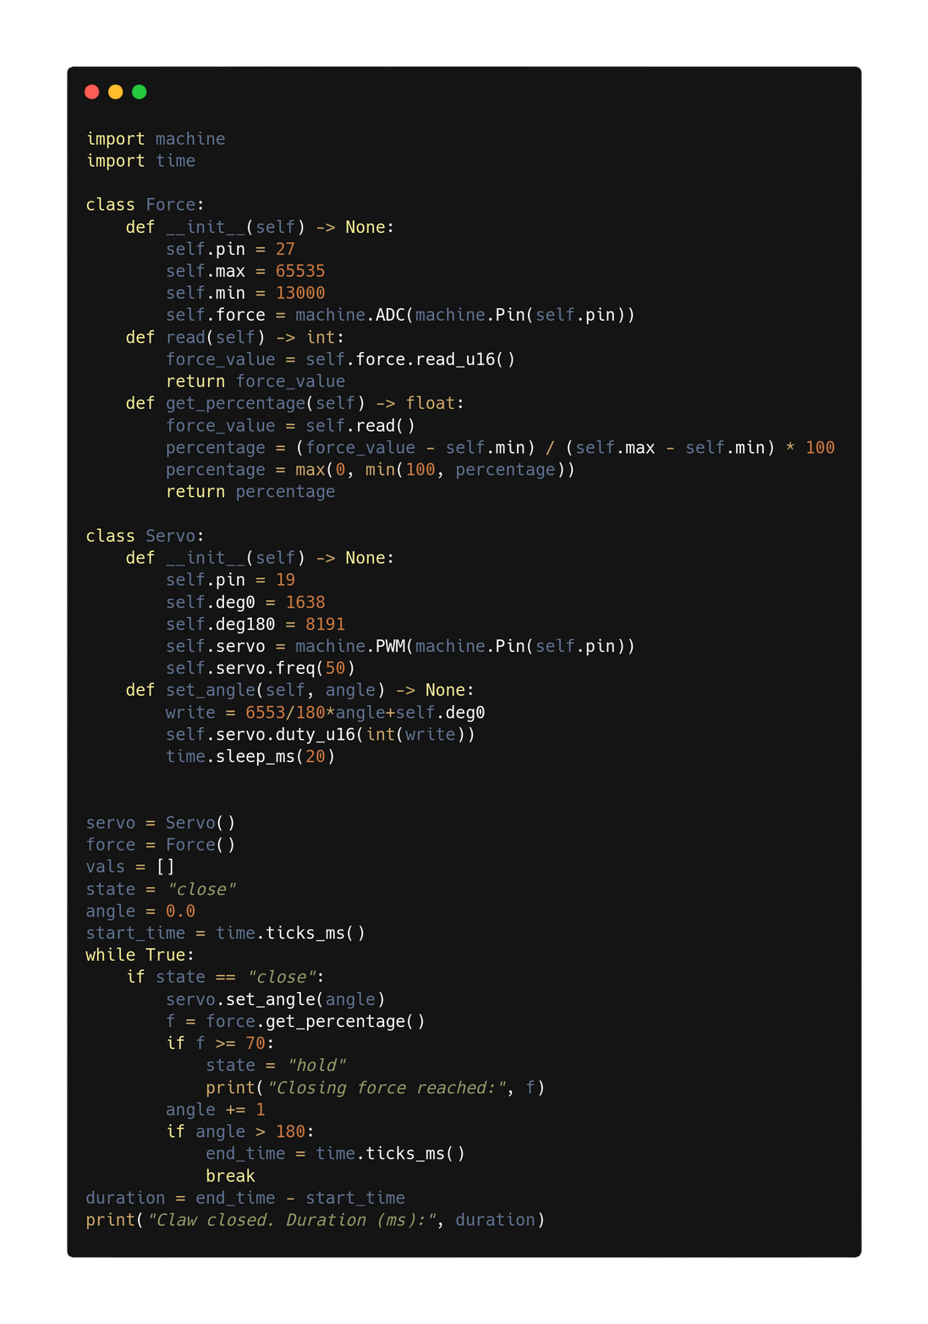
Code
MicroPython with Raspberry Pi Pico: What school provided, we knew Python well.
Github: for everyone on our team to edit.
Object (Force Class): store information about servo & pressure sensor
Helper functions: used throughout the code
Proof of concept: servo turns until the sensors sense enough pressure, at which point it stops moving.

Slide 19
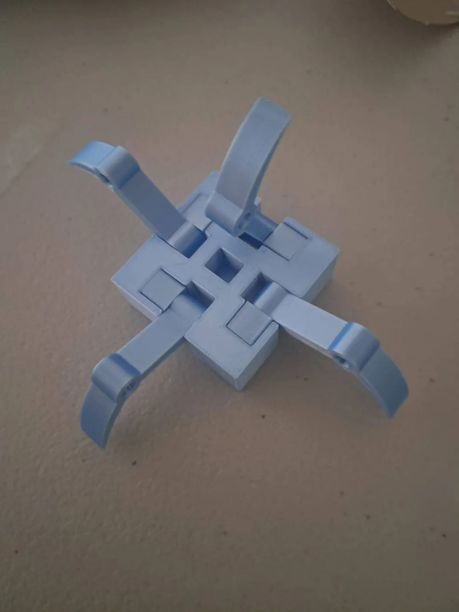
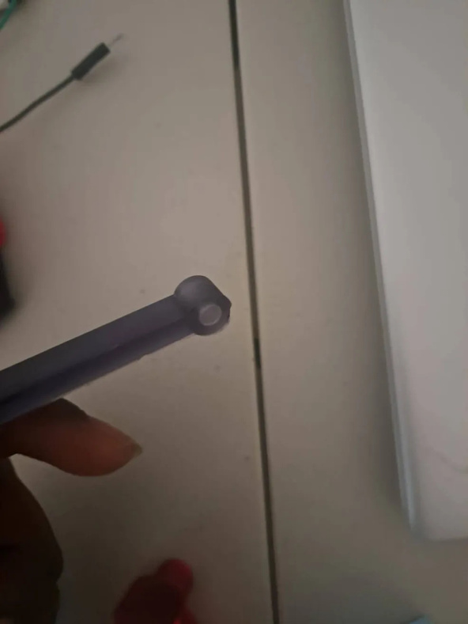
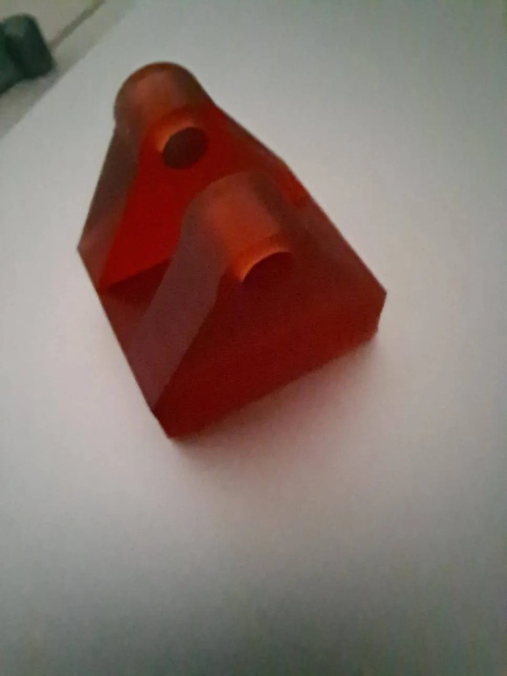
Proof of Concept Model
Early prototypes
See page 14-15 of the Innovation Design file

Slide 20
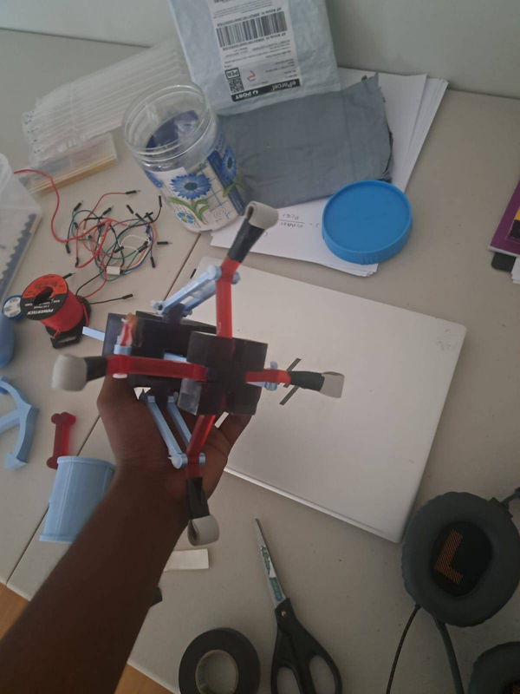
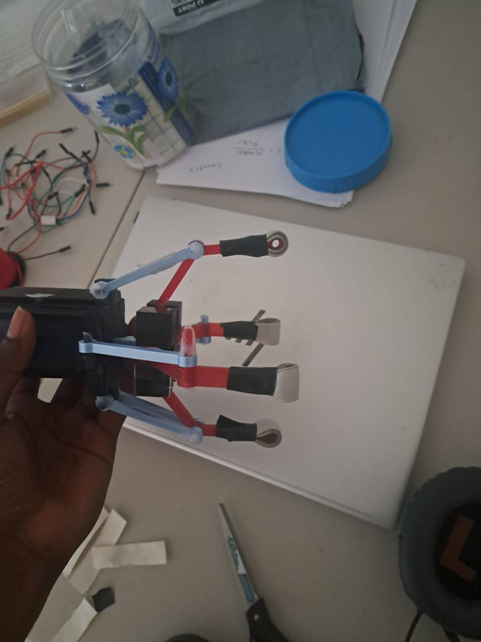
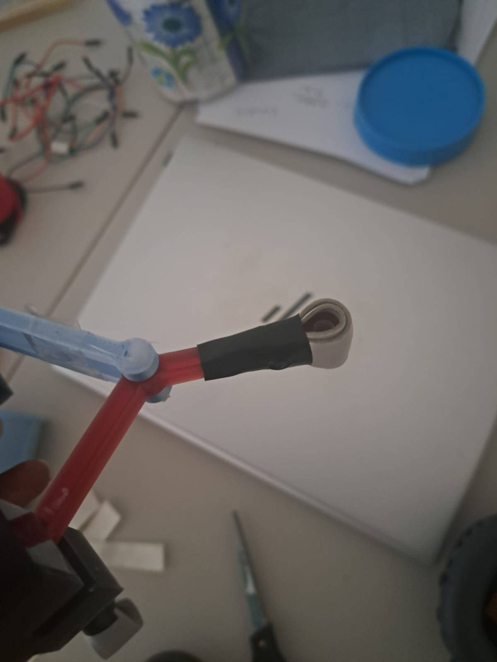
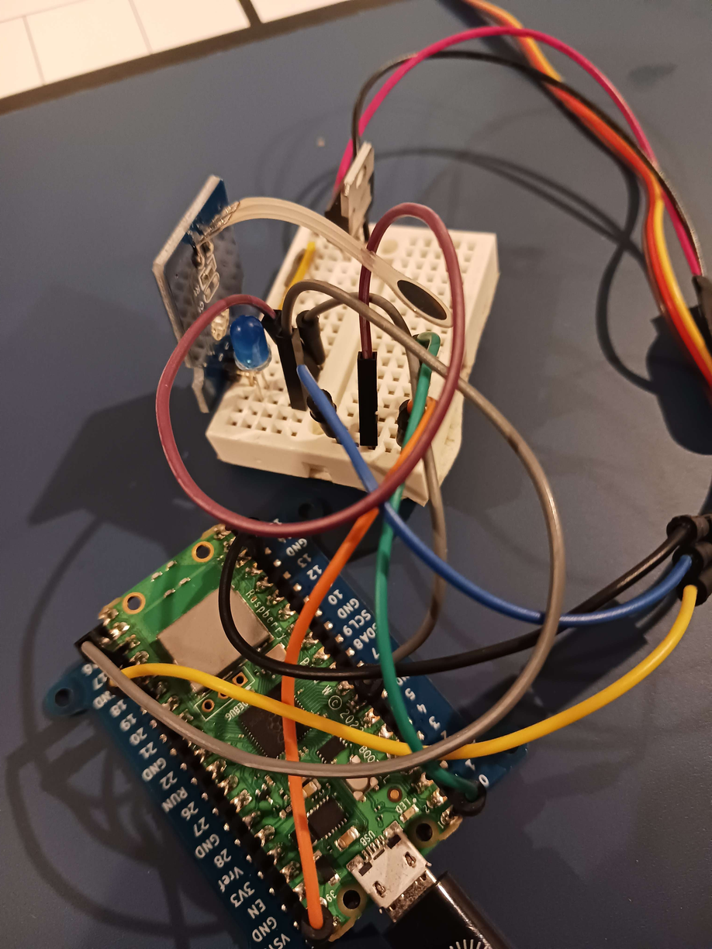
Proof of Concept Model
Later iterations
See page 14-15 of the Innovation Design file

Slide 21
Testing
Artefact | Number of Attempts | Grams of Force
Bone | 2 | 26
Anchor | 5 | 96
Vase | 3 | 411
Chest | 3 | 288
Using the new claw, we ran tests, recording how many attempts it took to pick them up. We also found the optimal grams of force.
See page 15 - 16 of the Innovation Design file
Notes:
By using our newly made claw, we recorded the amount of attempts needed to catch our test objects with the grams of force we decided was optimal for the different objects.

Slide 22
Impact on the Environment
Allows archeologists and other professions to reduce the risk of damaging delicate objects.
Mitigates contamination risks from industrial grippers, that could kill or injure animals in the vicinity of the manipulator arm.
See pages 15-16 of the Innovation Design file

Slide 23
Impact on Others
Main: Archaelogists.
Other fields: Science, mining, infrastructure, repair.
Reason: Collecting objects is easier, more freedom and sensory input. Could also grip other objects (like screw or bolts).
See pages 15-16 of the Innovation Design file
Notes:
Our project would impact a wide range of different people. Though mainly designed for archaeologists, our ROV manipulator arm could impact other professions: science, mining, infrastructure and repair work. It would help all of these professions by making work easier, providing more freedom and sensory input, as well as making object collection easier. The grippers would also help grip screws, bolts and other mechanical objects.

Slide 24
Part 3
Using feedback

Slide 25
FEEDBACK
We sent out a forms link with details about our innovations project to friends, family and got expert responses (explained in detail later).

Slide 26
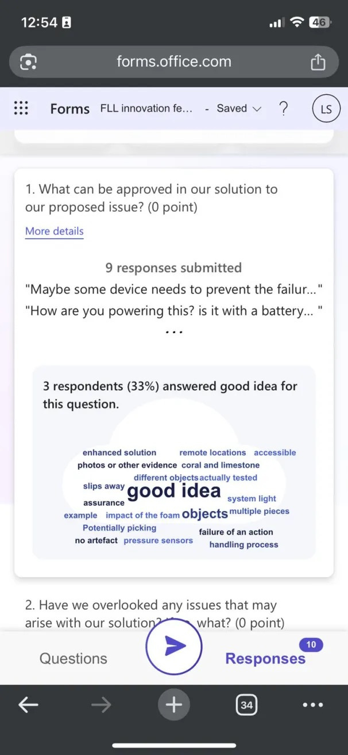
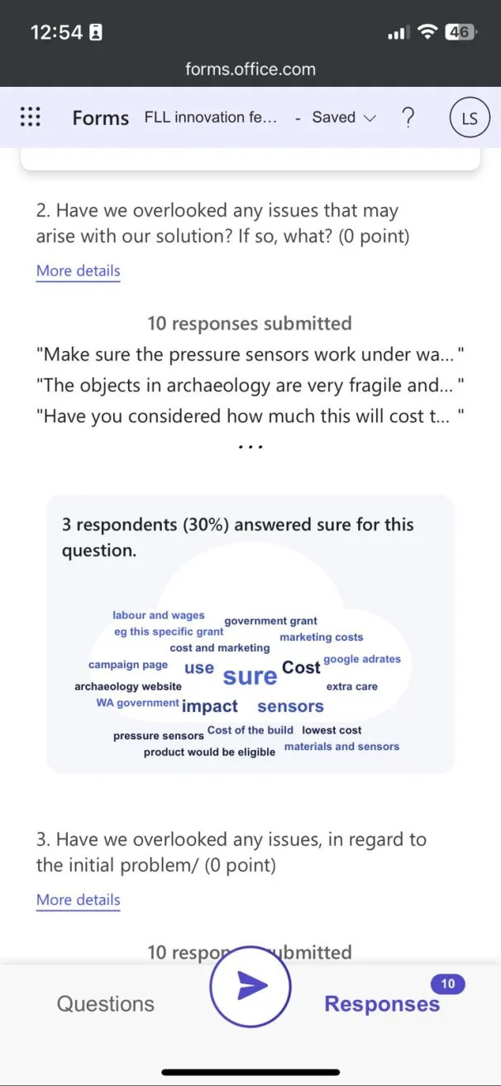
Analysing Forms
The forms had several key points:
how the arm would be powered from the ROV
the impact on the foam against different objects
evidence of how the foam doesn’t damage artefacts
manufacturing costs
feasibility of mass production

Slide 27

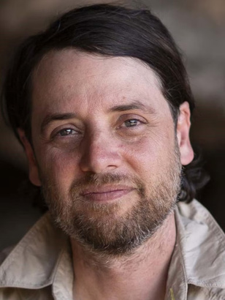

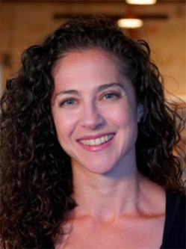
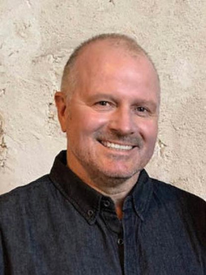
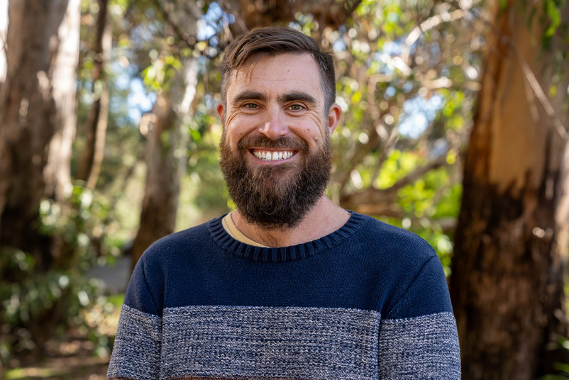
Expert Opinion
These were some of the experts we contacted about our problem or solution.
David Howard: CSIRO robot design and interactions group leader
Josh Pinskier: CSIRO senior researcher in soft robotics
Mick O’Leary: associate professor in UWA
Deb Shefi: Curator of Maritime Archaeolgy at the WA Museum
Ross Anderson: President of the Australasian Association of Maritime History
Todd Bond: Deputy Director of the Minderoo-UWA Deep-Sea Research Centre
See pages 17-20 of the Innovation Design file

Slide 28
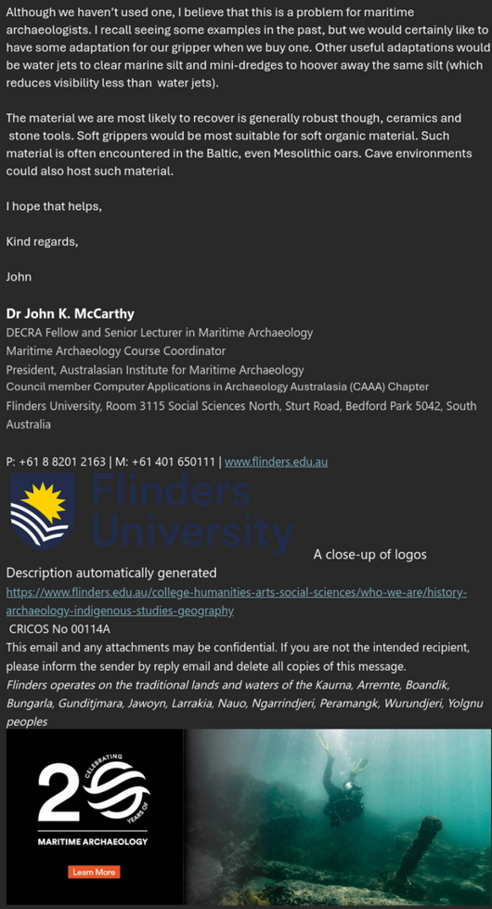
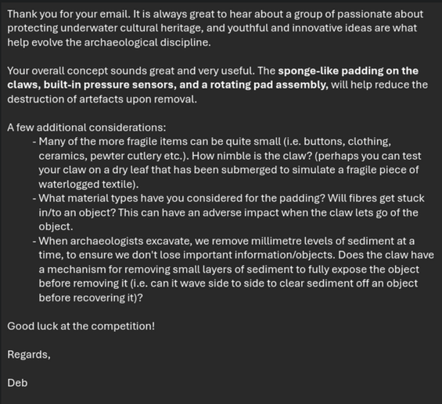
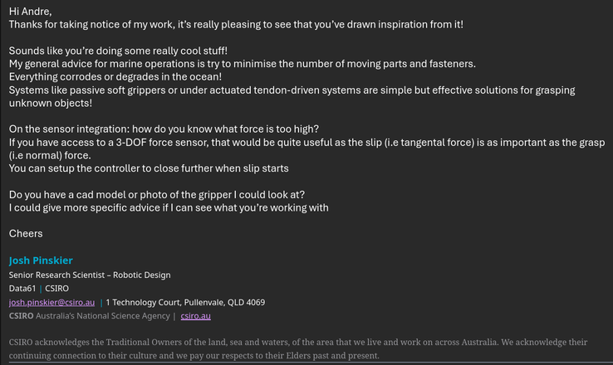
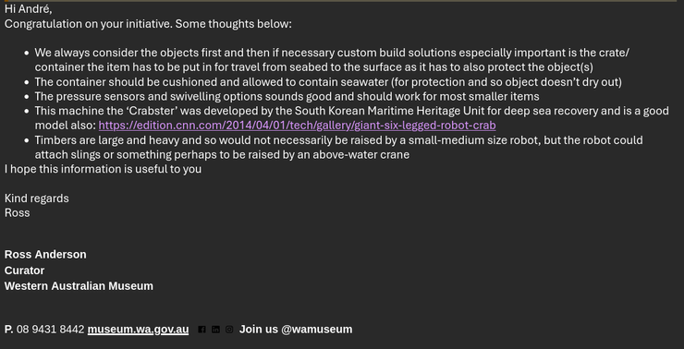
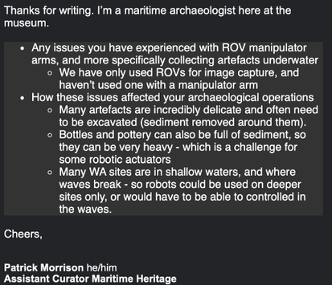
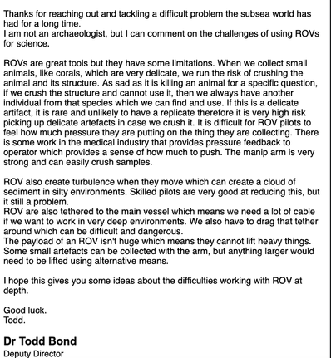
Responses
See page 21-26 of the Innovation Design file

Slide 29
Feedback improvements
From David Howard, a CSIRO expert.
Issue: Deep sea pressure could interfere with sensor readings
Fix: Include an external pressure sensor to measure ambient pressure.
Benefit: Allows us to subtract it and determine the true/neutral gripping force.
Issue: Material on claw tips were too hard and smooth, reducing grip.
Fix: Use a softer foam material.
Benefit: Claw can slide around and grip fragile artefacts better. Don’t have to rely on electronics for pressure sensing. Reduces damage of fragile artefacts.
See page 17 of the Innovation Design file

Slide 30
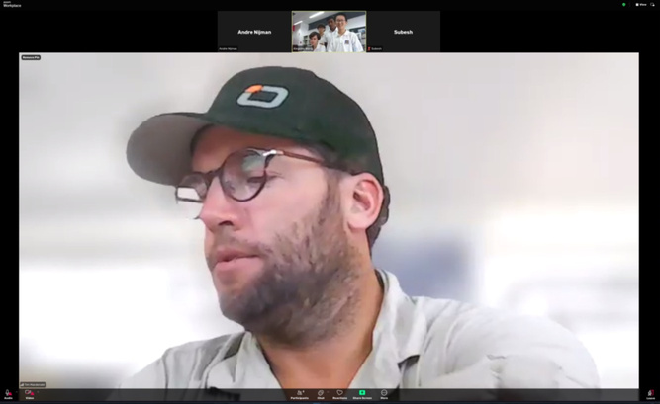
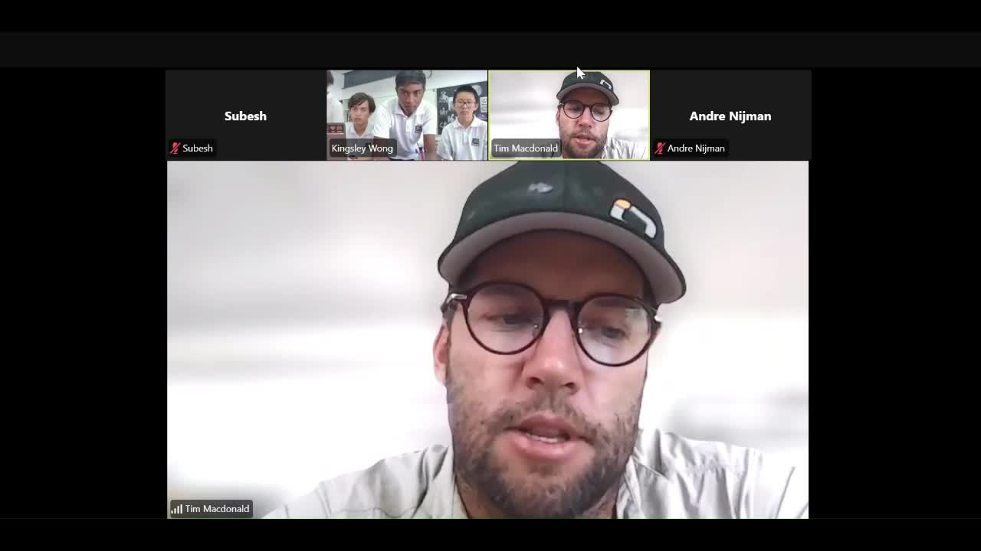
Call with Tim MacDonald
Key points:
Use 3D printed materials
The simpler, the better
For underwater pressure, can use oil filled containers
Problem:
Agrees that the problem is currently prevalent
Solution:
Little companies have tried to use pressure sensors in claws
Our design is better than using a pressure collector
See page 26 of the Innovation Design file

Slide 31
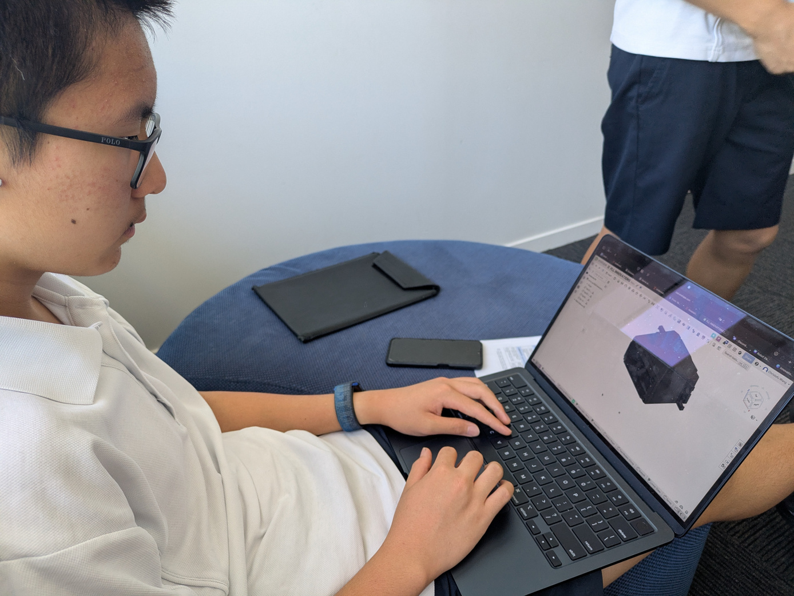
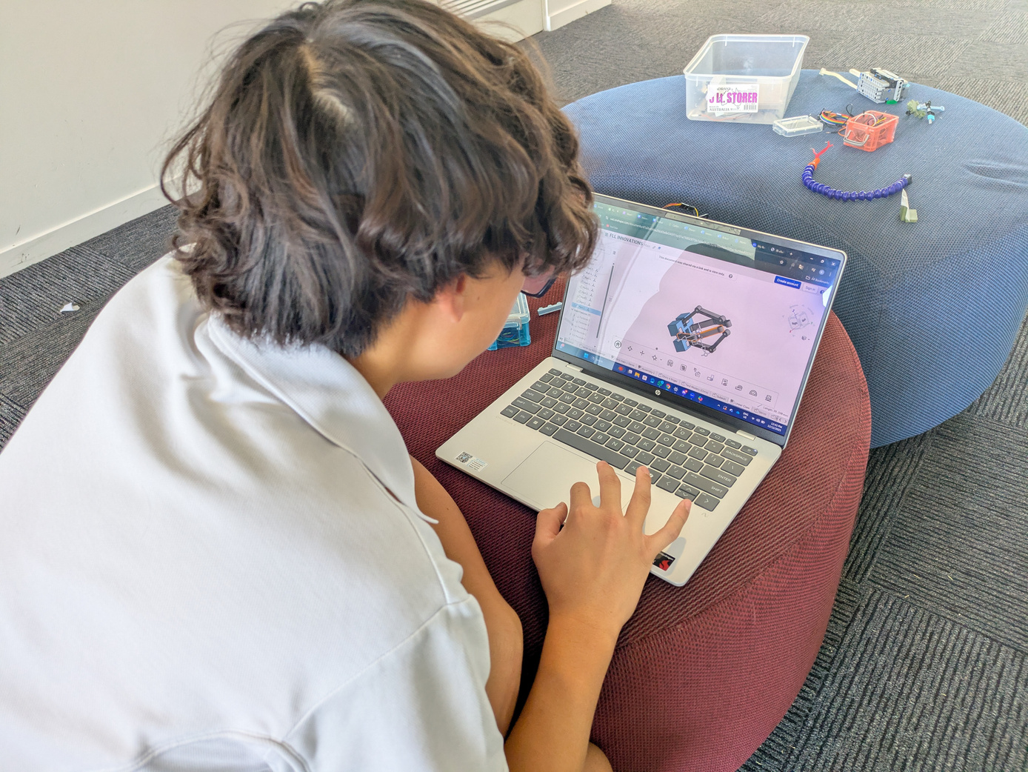
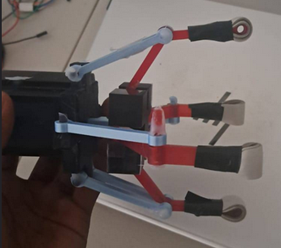
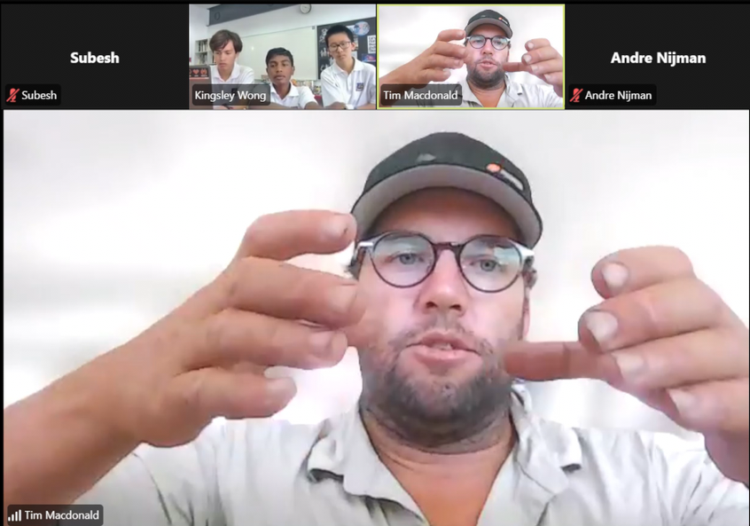
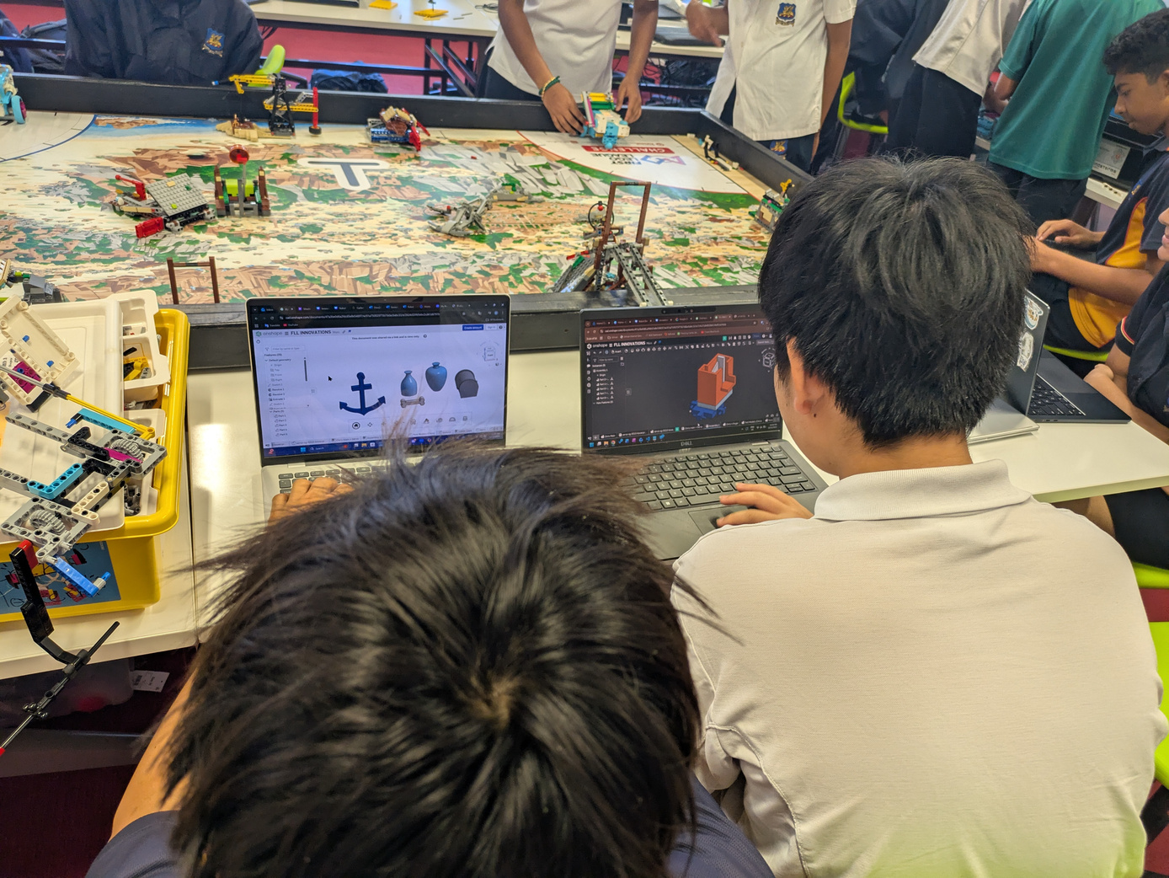
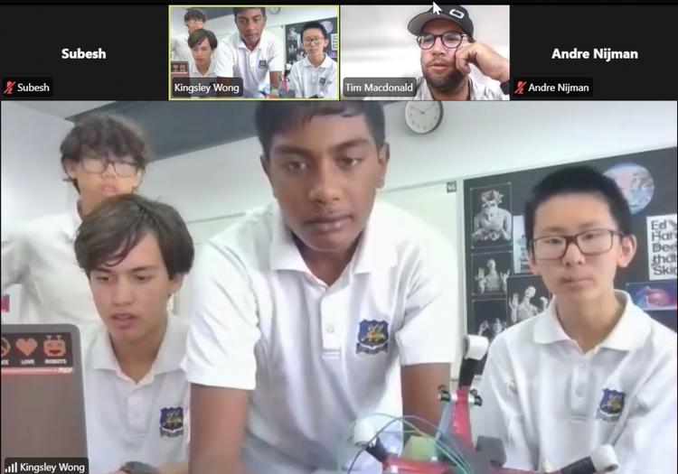
Yay inno photos!! LOCK IN

Slide 32
Demonstration

Slide 33

Robot Design Now...
Lebob 2025

